Slide 1

Using this Slide Deck
This slide deck is like a workbook. Add in and take out what’s needed.
  Use the template slides that work for your event. Right-click>Duplicate Slide as needed. Delete the others.
Update an image – Right- click > Change Picture.
Some slides contain suggested script. Update this script as needed.
Add your thoughts about the session topic into the Notes Panel. Print notes prior - File>Export>Create Handouts>Notes below slides OR use multiple monitors so the notes panel can be visible.
Contact your SciSoc program manager for support as needed.

Slide 2
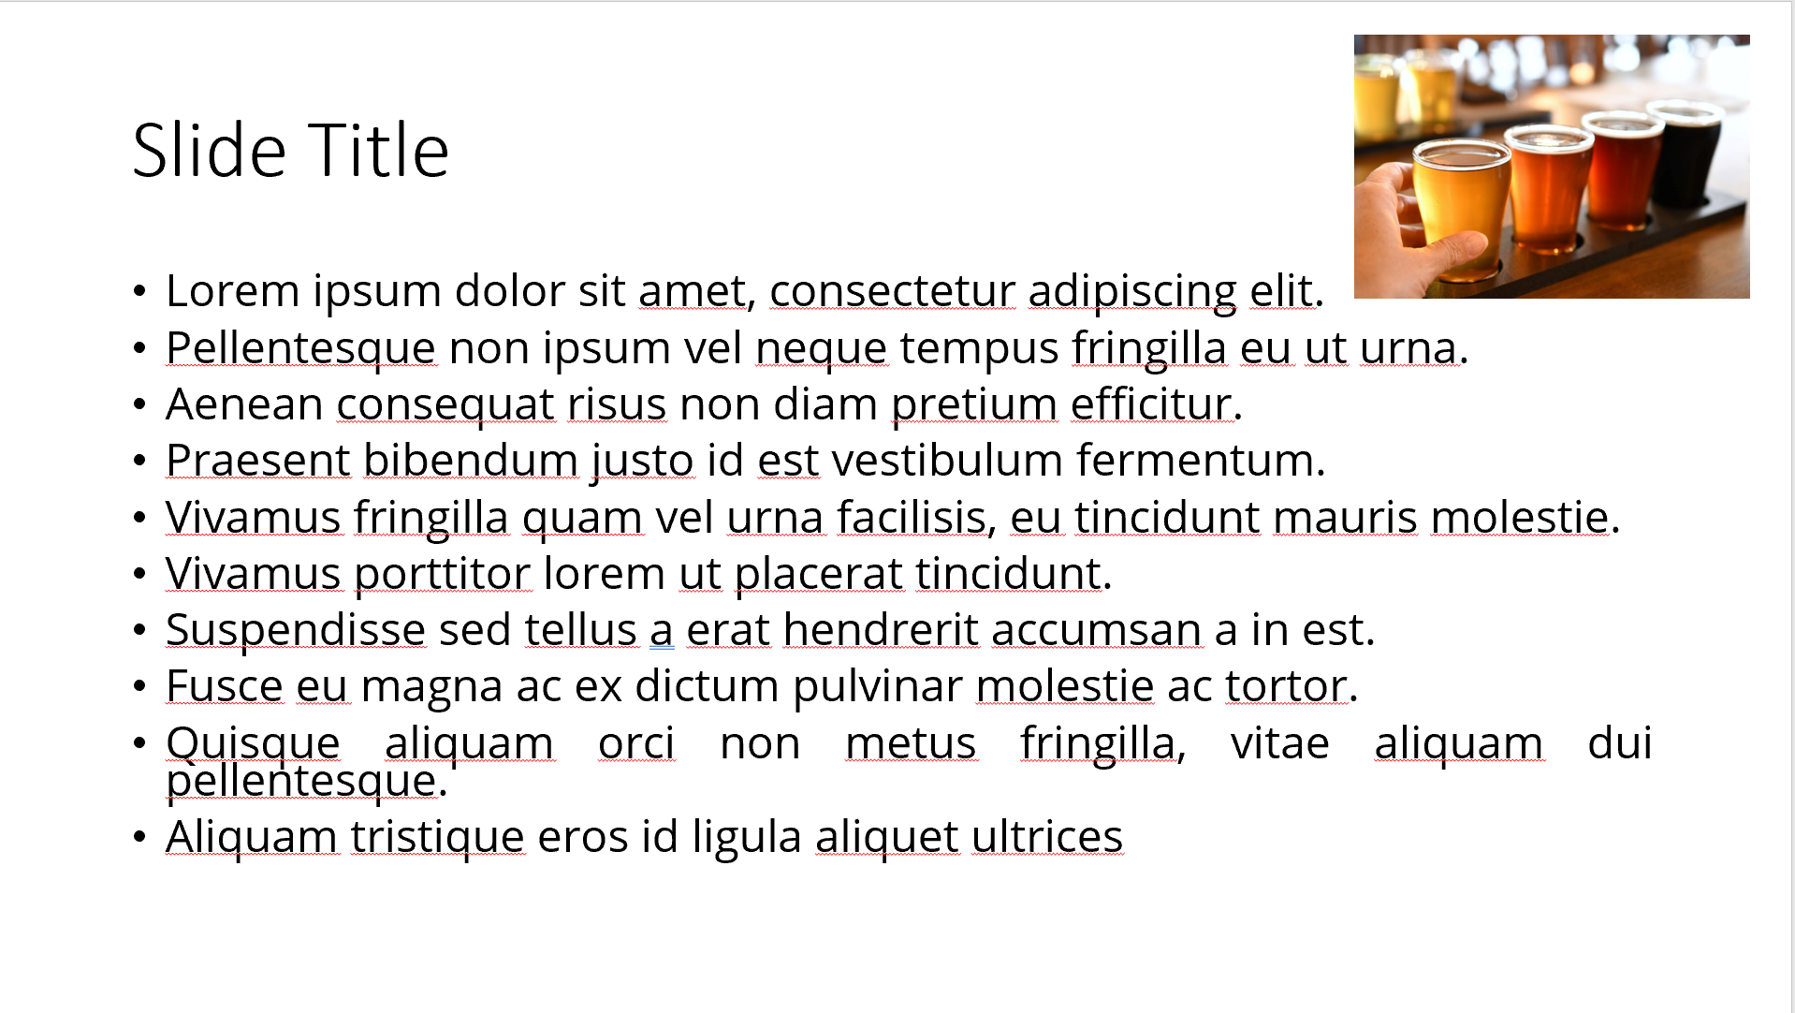
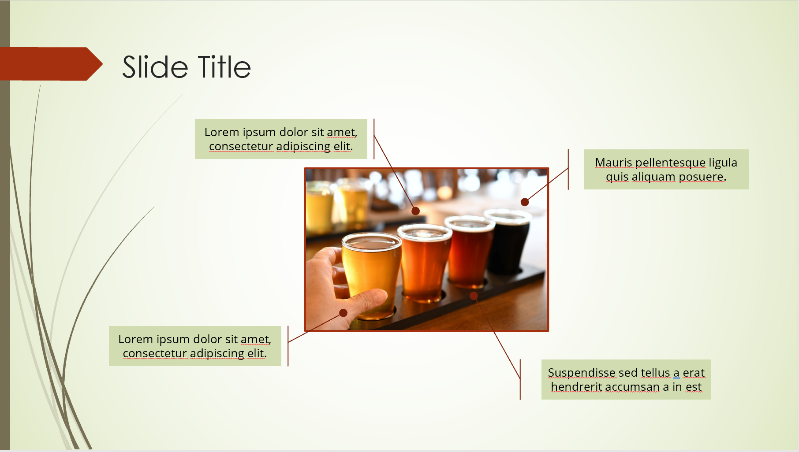
Ensure Slide Clarity
Contact your SciSoc program manager for support as needed.
Notes:
The clarity of your slide and what you put on it should enhance your message.
Ensure the following:
Ample white space. Don’t crowd the slide.
Ideally 1-2 ideas discussed per slide.
Avoid dense bullet point slides and a content dump. Put those details in your notes instead.
Aim for foreground/background color contrast.
Use purposeful images or illustrations that you can talk to from your presenter notes.

Slide 3

Get Copyright Permission
Contact your SciSoc program manager for support as needed.
This Photo by Unknown Author is licensed under CC BY-NC
Notes:
As a reminder, you must own or have permission to use all media (images, illustration, video) or documentation used in this presentation.
This is an issue that can have financial repercussion to your association and one we are careful to adhere to.

Slide 4
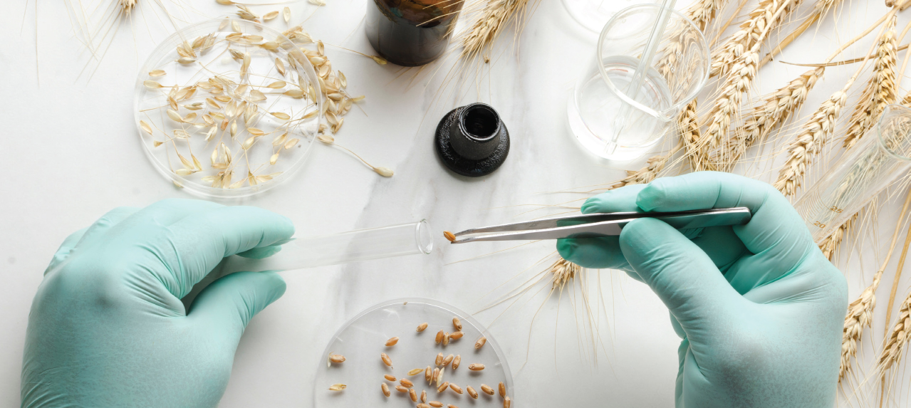
Presentation Title
Notes:
SAY:
Good morning everyone and welcome to my talk [presentation title].
I would like to introduce myself. I am [insert name], from [company] and I am [position at company, brief relationship to association or topic].

Slide 5
Title and Content Layout
First level bullet
  increase list level for sub-bullets

Slide 6
Two Content Layout
First level bullet
  second level
    third level
First level bullet
  second level
    third level

Slide 7

Title, Content & Photo Layout
Click on photo to replace

Slide 8
Chart or Graph
Use simple gray box for callouts

Slide 9
Icons
Icons can be recolored using shape fill. Icons can be used with yellow hex shape (center vertically & horizontally with shape then group). To resize icon and/or shape, use the shift key to keep the original proportions.

Slide 10
Video title

Slide 11

Section Header Layout
Subtitle if needed
Notes:
SAY:
DO:
Use this as a break between events, perhaps a pause for conversation between speakers in a panel or other – member engagement involvements movement of visual elements, conversation, and other. Avoid sitting on one slide for more than a few minutes.

Slide 12

REQUIRED

